Slide 1
Medical Condition Prediction
TEAM :
Anurag Singh
Aikhoje ikhuoso
Ben biju Jacob
Gabriel ntoweng
Happiness ndubisi

Slide 2

Problem Statement
To develop a predictive model capable of detecting the presence of three specific medical conditions based on measurements of health characteristics. The model will aid researchers in identifying potential patients who may have one or more of the specified medical conditions without requiring a long and intrusive process of data collection from patients.

Slide 3

Data Set
Unique Identifier (Id): Each observation in the training set is assigned a unique identifier, allowing us to differentiate and track individual data points.
Anonymized Health Characteristics (AB-GL): The training set contains fifty-six health characteristics, all of which are numerical, except for one called "EJ," which is categorical. These characteristics are encoded and anonymized to protect the privacy of the patients.
Binary Target (Class): The binary target variable, denoted as "Class," indicates whether a subject has been diagnosed with one or more of the three medical conditions (Class 1) or if they do not have any of these conditions (Class 0).

Slide 4
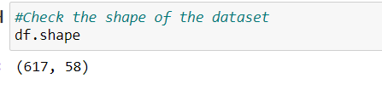
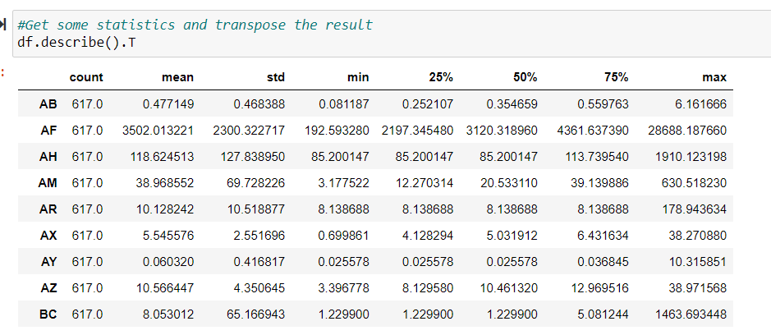
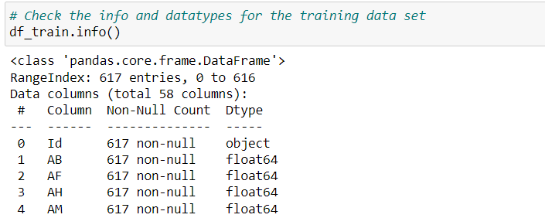
Exploratory Data Analysis
The Shape for the dataset is (617,58)
We Checked the statistical information
We Checked for the nulls and datatypes of each attribute BQ,CB,CC,DU,EL,FC,FL,FS and GL were having missing values

Slide 5
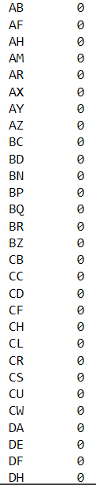
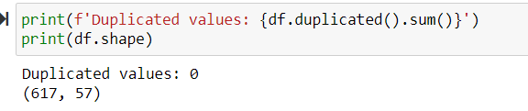
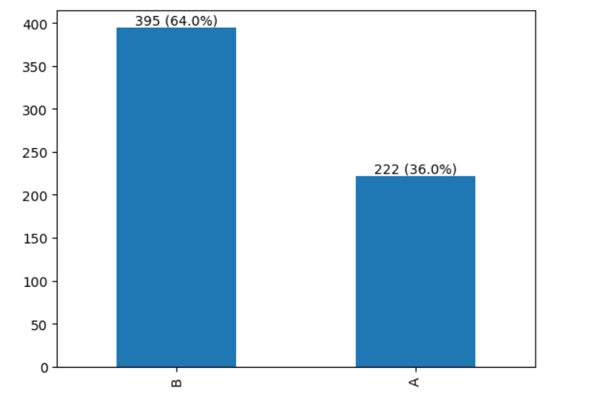
Data Preparation
Checked for duplicates and no duplicates found
We used hot deck imputation method to impute the missing values
Datatype of EJ Column is Object with two values(A,B)
Plotted a bar graph to see the percentage of A and B in EJ Column

Slide 6
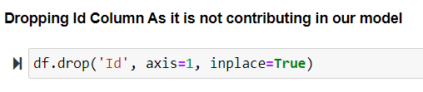
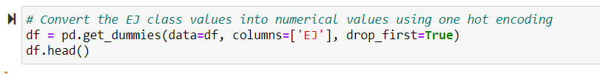
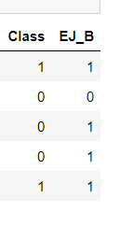
Feature Engineering
Dropped the ID Column as its not contributing to the model
Encoded EJ to convert it to binary.

Slide 7
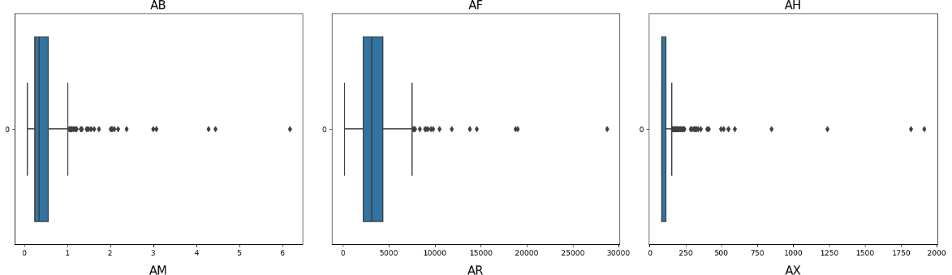
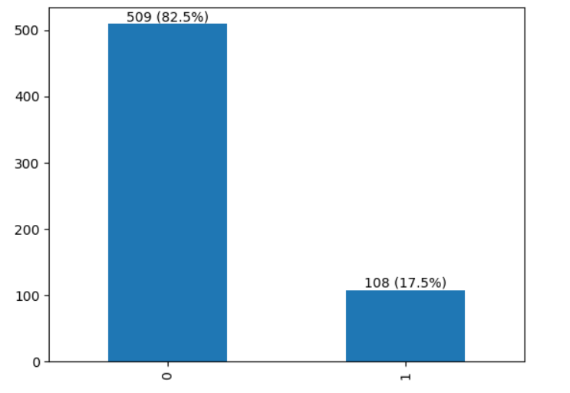
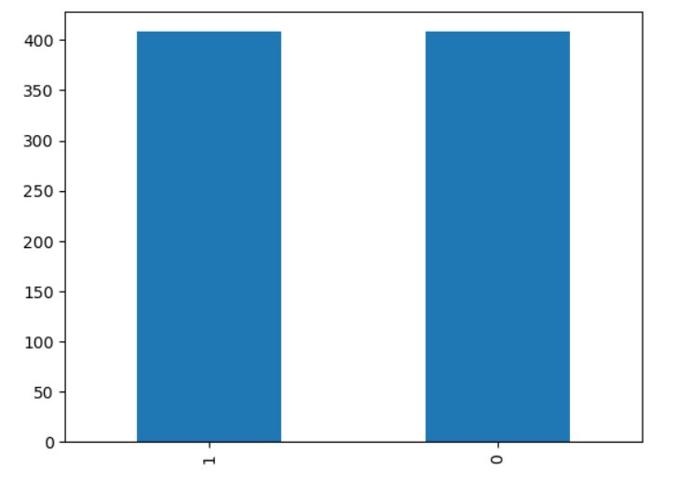
Feature Engineering
The outliers were checked, and we see some outliers, but we understand that the outliers are for health characteristics which can be possible and reducing the outliers may affect the accuracy of the model
The target variable class is imbalanced, and we used SMOTE oversampling technique to balance the target variable in the training data

Slide 8
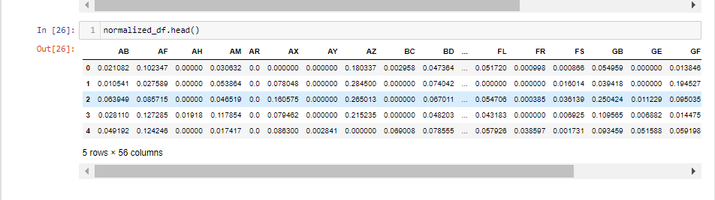
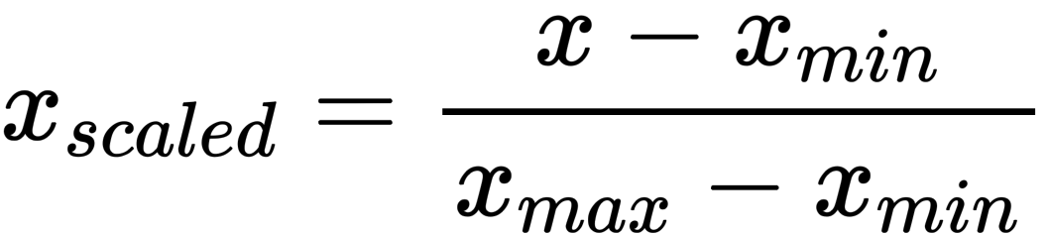
Feature Engineering
Feature Scaling
Min-Max scaling is useful when you want to preserve the original distribution of the data but rescale it to a specific range.

Slide 9
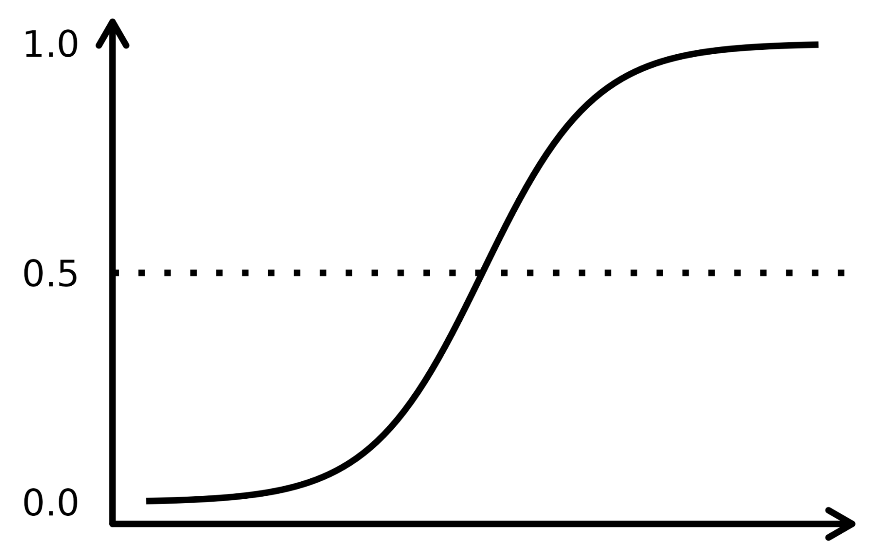
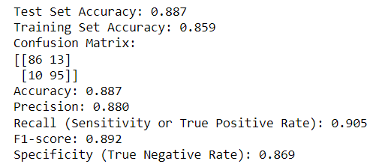
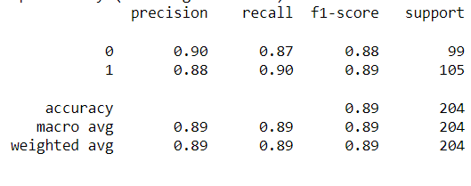
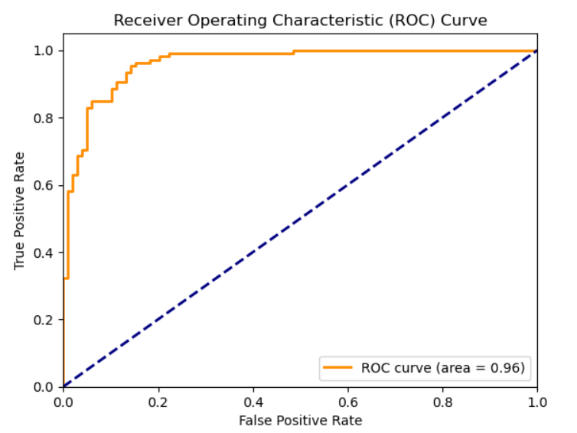
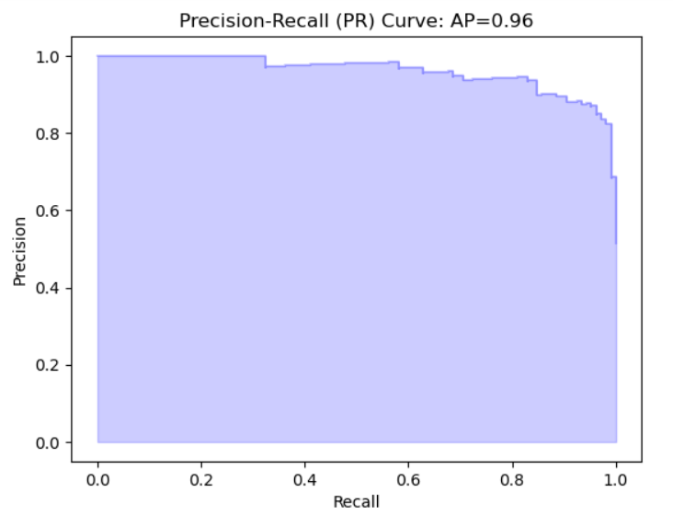
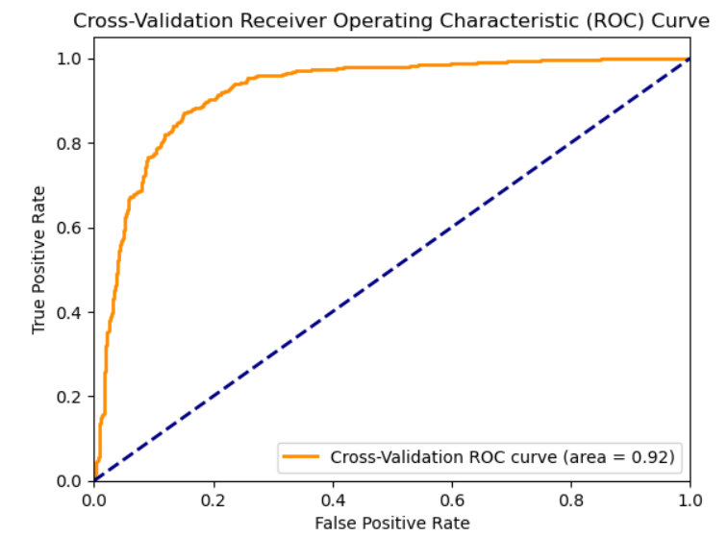
Modeling
Logistic Regression

Slide 10
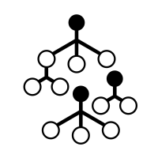
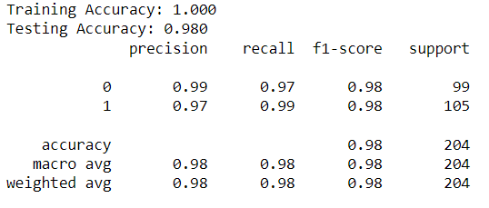
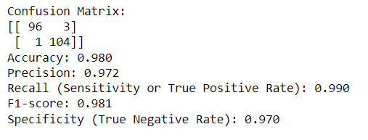
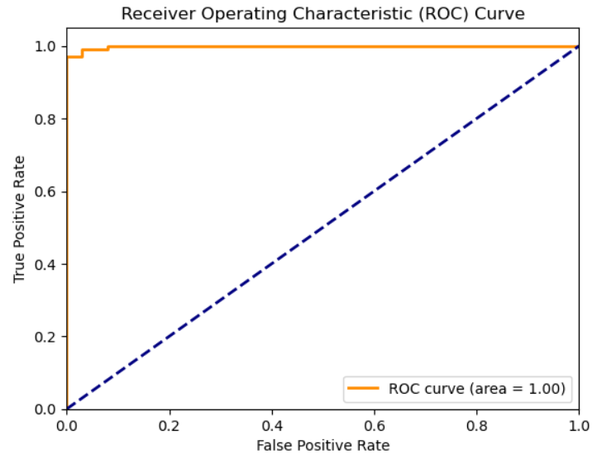
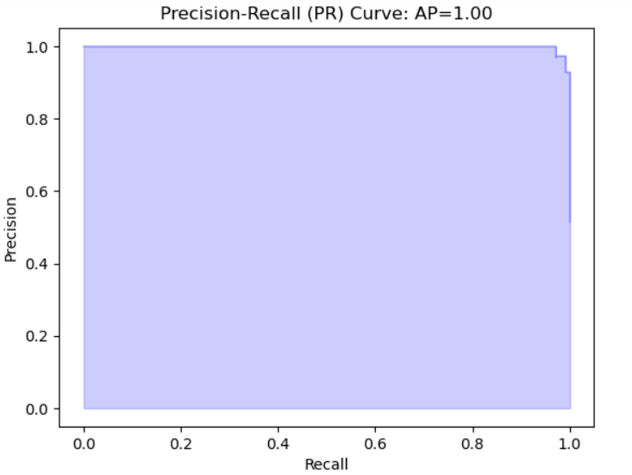
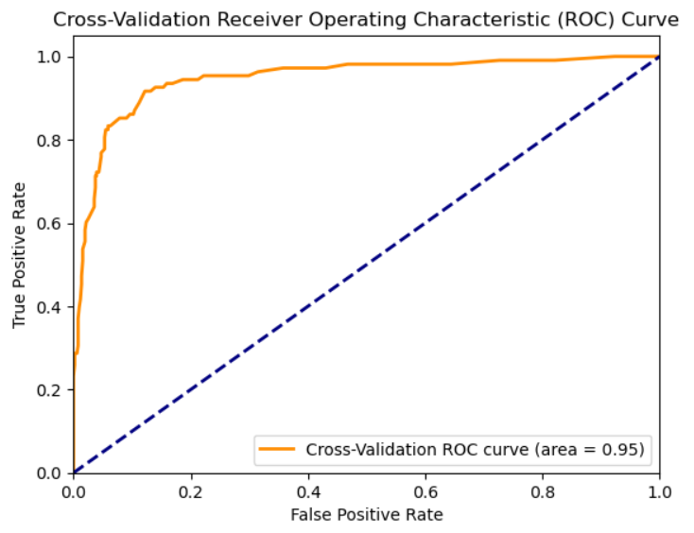
Modeling
Random Forest

Slide 11

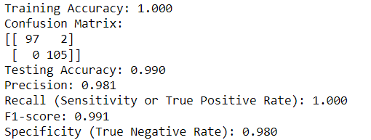
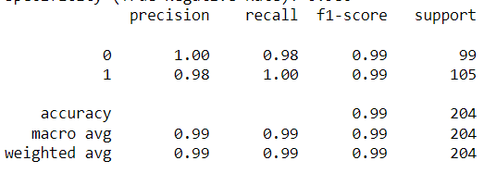
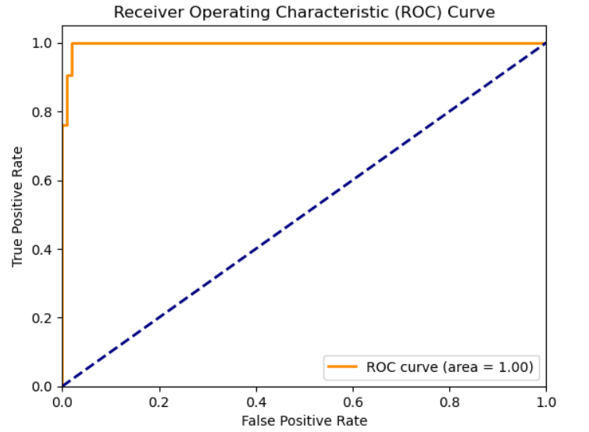
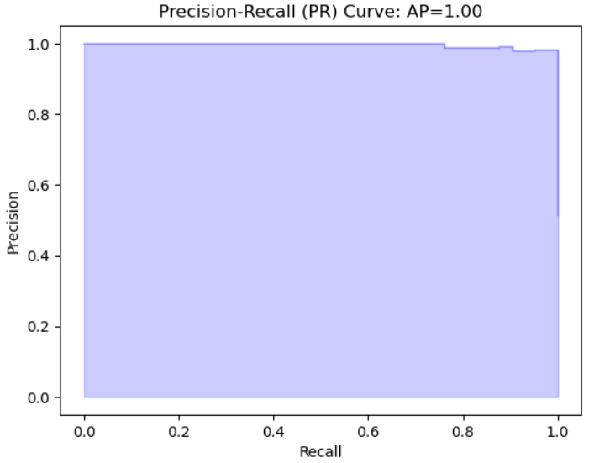
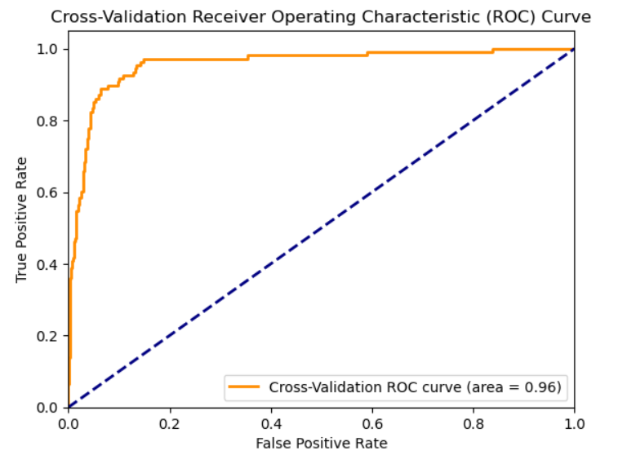
Modeling
XG Boost

Slide 12
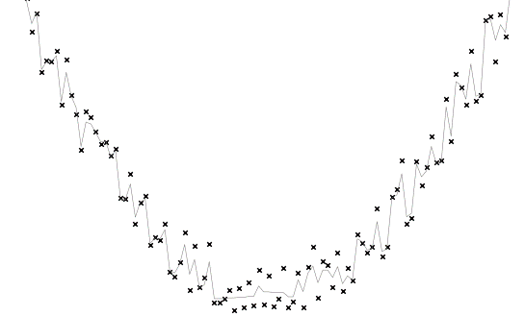
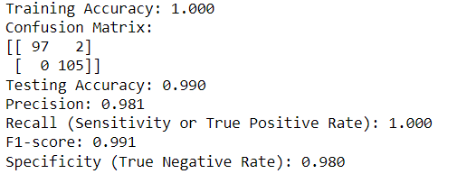
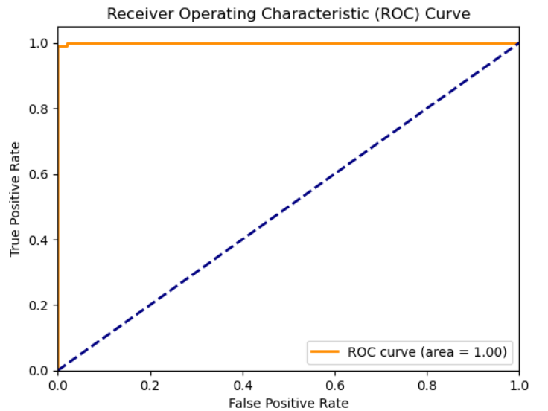
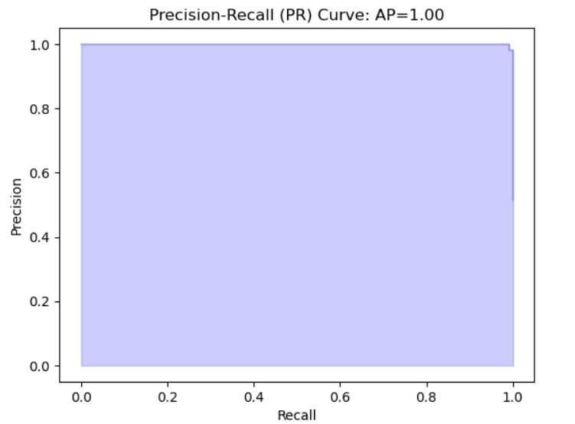
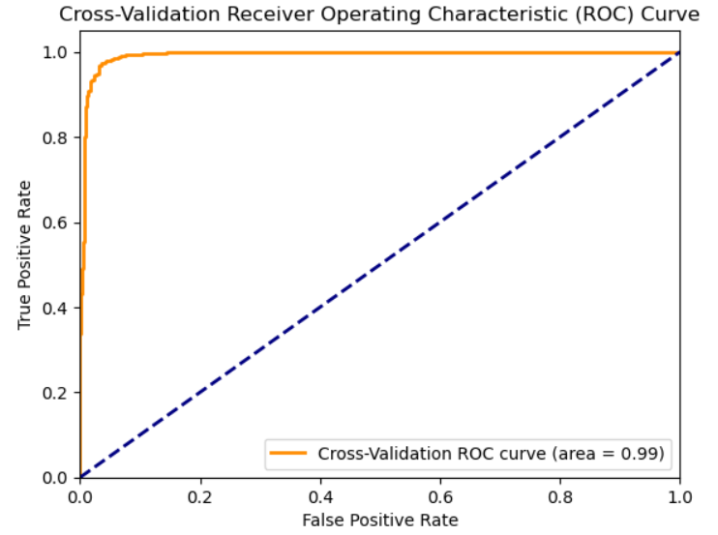
Modeling
Voting Classifier

Slide 13

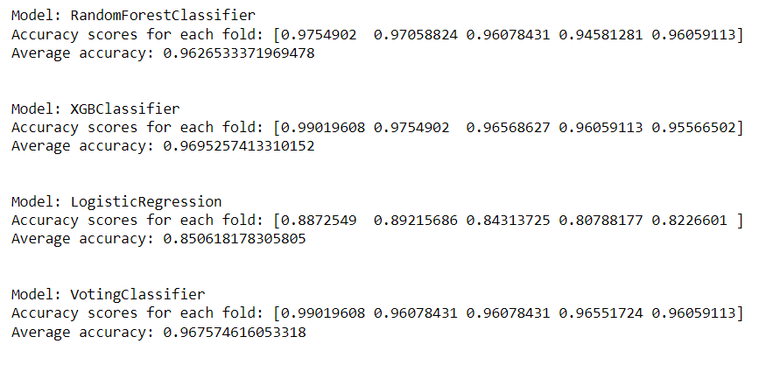
Modeling
Cross validation
RandomForestClassifier was a bit consistent across the five folds with an average accuracy of 96.26% This indicates that the model is capable of generalizing well to unseen data and is suitable for the classification task at hand.
XGBClassifier performed well with high accuracy across the folds, with an average accuracy of around 96.95%. The model has good performance, similar to the RandomForestClassifier.
LogisticRegression model had the least performace compared to other models with an average accuracy of 85.06%. Though it still shows decent performance, it is outperformed other models used.
The VotingClassifier demonstrated remarkable performance with consistently high accuracy scores across the five folds, achieving an impressive average accuracy of 96.66%.

Slide 14

Conclusion
After evaluating various classifiers for the classification task, the VotingClassifier emerged as the top-performing model. With an average accuracy of 96.66%, it consistently outperformed other models, including RandomForestClassifier and XGBClassifier. The VotingClassifier's exceptional ability to generalize well to unseen data makes it the most suitable and reliable choice for making accurate predictions in real-world applications.

Slide 15

Thank You
Thank You

